Slide 1
Splay Trees

Slide 2
What is Splay Tree?
A “balanced” search tree data structure
  May be balanced from a height perspective
  Will be balanced from an amortized perspective
A binary search tree in which operations that access nodes restructure the tree.
A splay tree is a binary search tree T. The only tool used to maintain balance in T is the splaying step done after every search, insertion, and deletion in T.
What if the node already exists? Splay from the existing node.
What if the node is not found? Splay from the last node visited.
“Blind” rebalancing – no height data is kept

Slide 3
Goal of a Splay Tree
Accessed item to top of tree
Repeat access will be O(1)
“Real” data access is usually repeated
Typical use is cache of data

Slide 4
Splay Tree
A splay tree is a balanced BST built using an “amortization” approach – do more work at every insertion, deletion, or search to save subsequent search time.
“More work”:
  What: Bring the accessed (i.e., inserted or searched, parent of deleted) node to the root.
  Why: It pays off if the accessed node is accessed again soon.
  How: Double-rotate – called “splaying.”
    Why double rotations for splaying?
      Double rotations tend to reduce the height more quickly than single rotations.
    What if the access path length is an odd number?
      One rotation must be a single rotation.
      Do it either at the bottom or at the top.
      The resulting tree structures may be different. Both are fine!

Slide 5
Splaying Operation
Splay(k): move a node k to the root through double rotation operations.
  Single rotation is not used in the splay tree (unless first or last rotation).
As a result, halve the depth of most nodes (excluding the root) encountered on the path from the root to the accessed node.
Splaying tends to (not always) keep the splay tree more balanced than the BST.

Slide 6
Splaying
Left and right rotations
zig-zig (left–left) or zag-zag (right–right)
  The order of rotations: top-down, which guarantees that the distance to every node encountered (except the root) is reduced to half.
  This case is different from that of the AVL tree, and brings the positive effect of “splaying”.
zig-zag (left-right) or zag-zig (right-left)
  The order of rotations: bottom-up, which guarantees that the tree height is reduced by one at each zig-zag rotation.
    This case is the same as that of the AVL tree.
zig (left) or zag (right)

Slide 7
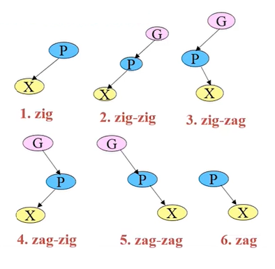
Six Possible Cases

Slide 8
Left and right rotation
Adel’son-Vel’skii and Landis (AVL)
Left rotation:
Y
X
T3
T1
X
Y
T1
T2
T2
T3

Slide 9
Right Rotation:
X
Y
T3
T1
Y
X
T1
T2
T2
T3

Slide 10
zig-zig and zag-zag splaying
The node x and its parent y are both left children or both right children.
  x is left child of a left child y with parent z
  x is a right child of a right child y with parent z
Replace z by x, making y a child of x and z a child of y, while maintaining the inorder relationships of the nodes in tree T.

Slide 11
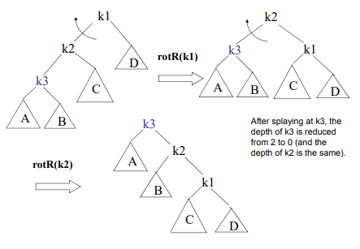
Concept
Splay (k3)

Slide 12
Before splaying
Example: x is 30, y is 20, z is 10
10
20
T1
30
T2
T3
T4

Slide 13
After splaying:
30
20
T4
10
T3
T1
T2

Slide 14
zig-zag and zag-zig splaying
One of x and y is a left child and the other is a right child.
  x is 2 levels below z
  x is a right child of a left child y with parent z
  x is a left child of a right child y with parent z
Replace z by x and make x have nodes y and z as its children, while maintaining the inorder relationships of the nodes in tree T.

Slide 15
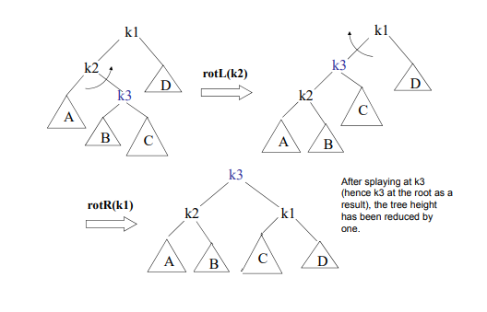
Concept
Splay (k3)

Slide 16
Before splaying
Example: z is 10, y is 30, x is 20
10
30
T1
20
T4
T2
T3

Slide 17
After splaying:
20
10
30
T1
T2
T4
T3

Slide 18
zig and zag splaying
X doesn’t have a grand parent(or the grandparent is not considered)
  x is just a child of the root
Rotate x over y, making x’s children be the node y and one of x’s former children u, so as to maintain the relative inorder relationships of the nodes in tree T.

Slide 19
Before splaying
Example: x is 20, y is 10, z is 30
10
20
T1
30
T2
T3
T4

Slide 20
After splaying:
20
10
30
T1
T2
T4
T3

Slide 21
Example: original tree
50
40
30
20
10

Slide 22
Example1: splaying
10
40
20
50
30

Slide 23
Splaying a node: original tree
20
25
40
10
30
50
15
35

Slide 24
Splaying a node: rotation 1
20
25
35
10
30
40
15
50

Slide 25
Splaying a node: rotation 2
35
25
40
20
30
50
10
15

Slide 26
Rules of splaying: Search
When search for key I, if I is found at node x, we splay x.
If not successful, we splay the parent of the external node at which the search terminates unsuccessfully.(null node)
Example: in the previous example, it can be for successfully searched I=35 or unsuccessfully searched say I=38.

Slide 27
Rules of splaying: insertion
When inserting a key I, we splay the newly created internal node where I was inserted
insert(node)
{
1. Insert the new node.
2. Let n be the length of the path traversed for the insertion.
Then,
a. If n = 2m (i.e., even number) then perform m double rotations.
b. If n = 2m+1 (i.e., odd number) then perform one single rotation followed by m double rotations.
}

Slide 28
Original tree
10

Slide 29
After insert key 15
10
15

Slide 30
After splaying
15
10

Slide 31
After insert key 12
15
10
12

Slide 32
After splaying
12
15
10

Slide 33
Rules of splaying: deletion
When deleting a key I, we splay the parent of the node x that gets removed. x is either the node storing I or one of its descendents.
If deleting from root, move the key of the right-most node in the left subtree of root and delete that node and splay the parent. etc.

Slide 34
Original tree
30
10
40
15
50
20

Slide 35
After delete key 30(root)
20
10
40
15
50

Slide 36
We are going to splay 15
20
10
40
15
50

Slide 37
After splaying
15
10
20
40
50

Slide 38
Alternate Rules of Splaying: Deletion
1. Splay-search the node. (That is, find the node and rotate it up to the root.)
2. Find the largest node in the left subtree of the root (or find the smallest node in the right subtree) and rotate it up to replace the root.
What is the point of bringing the node to the root after finding it?
The rationale for splaying is that a node accessed now is likely to be accessed again soon.
But, in the case of remove(node), the node is removed (so never accessed again) after all the work done to splay it up to the root.
Splaying tends to shorten the access path to every node encountered while finding the node.
The depth of each node is reduced at each splaying, especially in the beginning with a bunch of zig-zig cases. Of course, this depth reduction does not happen all the time, but is the trend.

Slide 39
Complexity
Worst case: O(n), all nodes are on one side of the subtree. (In fact, it is Ω(n).)
Amortized Analysis - Only consider the splaying time, since the time for perform search, insertion or deletion is proportional to the time for the splaying they are associated with.
A single operation: O(logN) average, O(N) worst. But, the worst case occurs less frequently than the BST.
Searching for M nodes: O(M·logN) for both average and worst.
Inserting N nodes: O(N·logN) for both average and worst.
The amortized running time of a single operation takes O(logN).
Note. Compare with the BST case, where searching for M nodes and inserting N nodes take O(M·N) and O(N²), respectively.

Slide 40
Review Splay Tree
A “balanced” binary search tree.
Doesn’t need any extra information to be stored in the node, ie color, level, etc.
Balanced in an amortized sense rather than height sense.
Running time is O(mlog n) for m operations
Can be adapted to the ways in which items are being accessed in a dictionary to achieve faster running times for the frequently accessed items.(O(1), AVL is about O(log n), etc.)

Slide 41
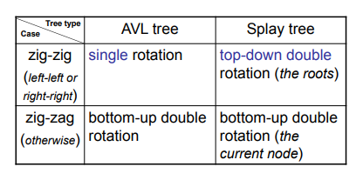
Rotations in AVL and Splay

Slide 42
Top-Down versus Bottom-Up Splaying
Bottom-up splay tree walks the access path twice – once for searching and once for splaying.
Top-down splay tree does the splaying while walking down the access path.
The splay tree has been shown to be faster than the AVL tree in benchmark experiments performed using "real" applications. All balanced BSTs in these examples are main-memory data structures and, thus, the run-time is very sensitive to the code implementation. Splay tree operations can be coded more efficiently (i.e., the top-down splay tree) than the AVL tree operations. This could be one reason for the benchmark results being in favor of the splay tree.

Slide 43
More Splay Trees Complexity
Given a number N, representing the number of elements in a tree: when performing any M consecutive tree operations, the run time is guaranteed to be O( M log(N) )
This guarantee does not prevent any SINGLE operation to take O(N) time, but only that there are really no bad input sequences.
Therefore, the amortized running time is O( log(N) )
It is obvious that if we want the overall amortized running time to be O(log (N) ), but we have the possibility of a single operation costing us O(N) time, there must be some way to prevent this.

Slide 44
Splaying Complexity
MUST prevent the “O(N)” operation from occurring often. That means the tree must be dynamic, that is: it must move in order to prevent those annoying O(N) operations from occurring too frequently.
So, once a node is accessed, it must be moved.
Every time access a node, perform single rotations up along the insertion path, selectively.

Slide 45
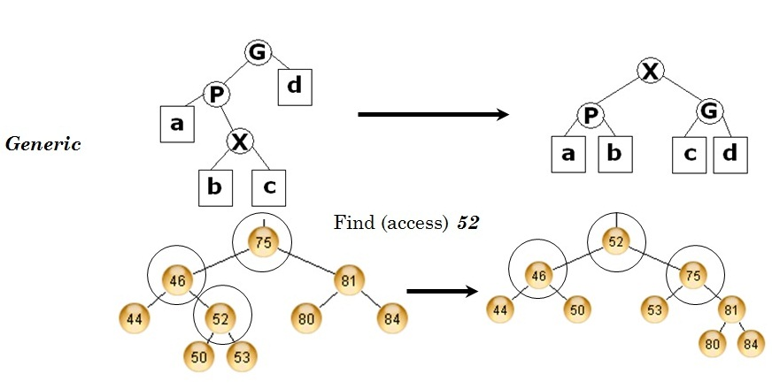
Another zig-zag example
X becomes the grandparent and P is left child, G is right child, and the other nodes fall into place

Slide 46
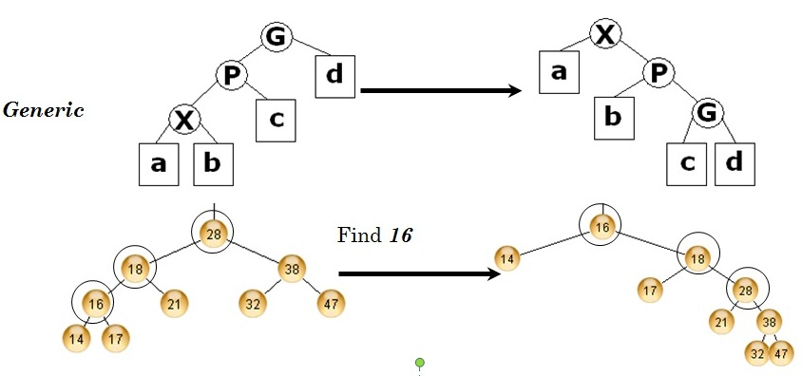
Another zig-zig Example
X becomes its grandparent, P (previously RIGHT parent is now LEFT child, and G, previously RIGHT Grandparent, is now LEFT Grandchild)

Slide 47
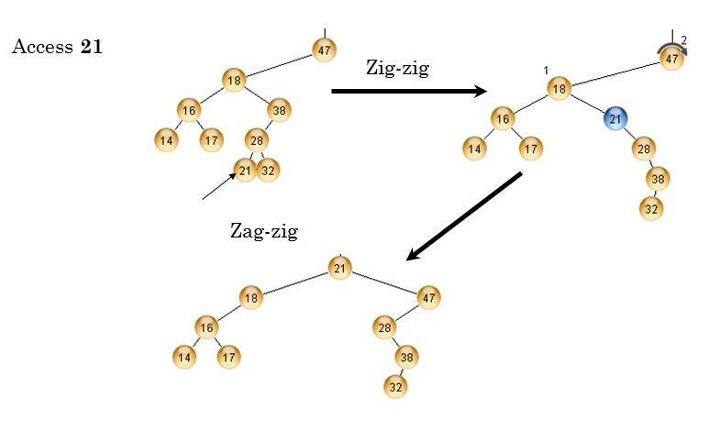
“Deep” Example of Splaying:
Multiple Double Rotations
Remember zag-zig is the mirror version of zig-zag

Slide 48
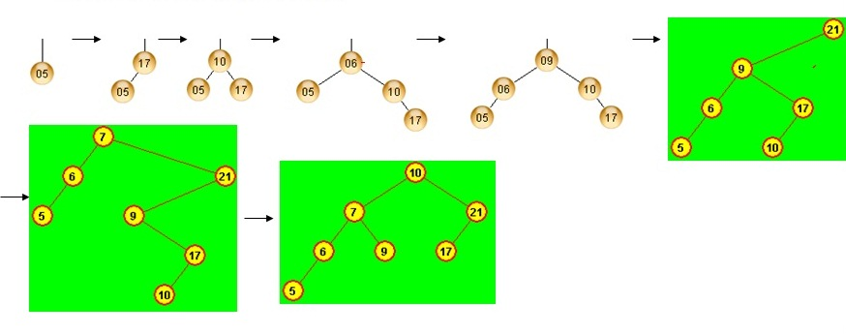
Insertion Example
Simple: Just insert as in a binary tree, and splay to the top using zigs and zags - Insert 5,17, 10, 6, 9, 21, 7, 10
Insert 5,17, 10, 6, 9, 21, 7, 10
Notice, when you try to insert 10 again, it just finds it and splays to the root.

Slide 49
Alternative Deletion Example
To delete a node
1. Access the node to be deleted (splay it to the root)
2. Remove the root (the element that was intended to be deleted)
3. Promote the LARGEST element from the LEFT subtree to become the root
OR you could promote the SMALLEST from the RIGHT subtree.
4. Now, make the original right subtree the right child of the NEW tree.

Slide 50
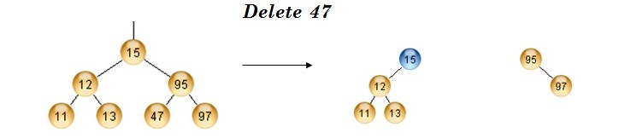
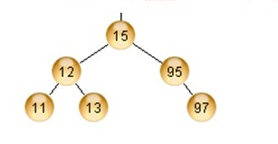
Deletion Example
Using a zig-zag, 47 is splayed to the top and removed
15 (the largest element of the left subtree) is now the root, and the 95->97 right subtree is its right child.

Slide 51
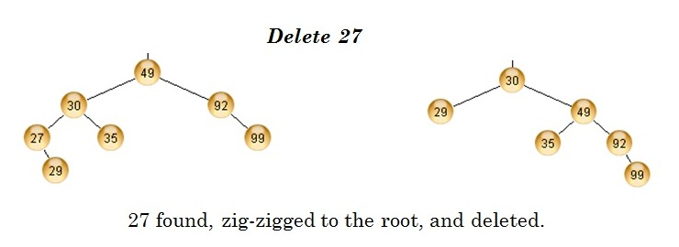
Deletion Example
You are then left with two subtrees, T_{L} (which is 29 alone), and the rest make up T_{R}.
In this case, the smallest in the right subtree is promoted.

Slide 52
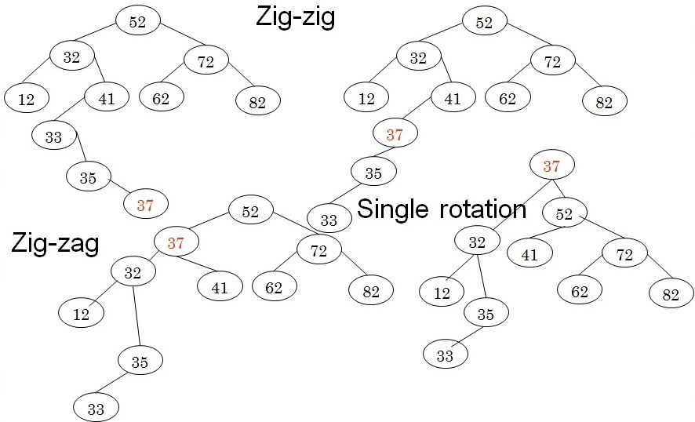
Show the result of finding 37 in the following splay tree

Slide 53
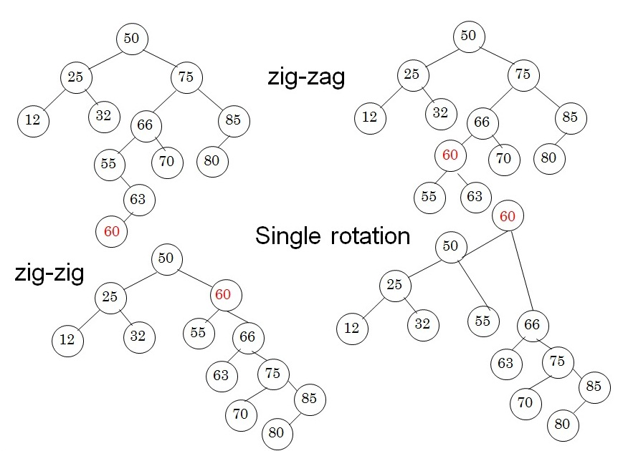
Show the result of doing a find 60 on the following splay tree

Slide 54
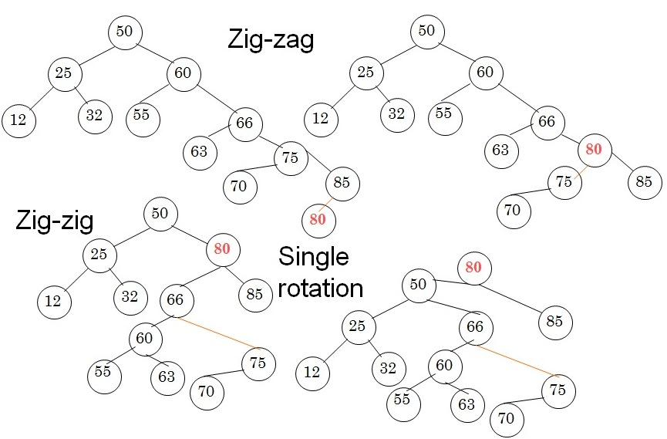
Show the result of doing a find 80 on the following splay tree

